Slide 1
A Loop Accelerator for Low Power Embedded VLIW Processors
Binu Mathew, Al Davis
School of Computing, University of Utah
Deepika Ranade
Sharanna Chowdhury

Slide 2
“Super” DSP
VLIW
Specialized on-chip memory system
scratch pad memory
cache banks
bit-reversal
auto increment addressing modes
Clustered execution units
VLSI rocks ☺
ILP limitation
Improve throughput
Timely data delivery to execution units
Limited memory, power
SW control

Slide 3
Author’s solution: Sneak peek
Multiple SRAM
Distributed Address Generators
Loop Acceleration Unit
Array Variable Renaming

Slide 4
VLIW Processor Architecture
Address Generator
x 2
Address Generator
x 2
Address Generator
x 2
Loop
Unit
PC
SRAM 0
SRAM 1
SRAM n
…
Interconnect
U Code
Memory/
I-Cache
Decode Stage
Function Units
x 8
micro code

Slide 5
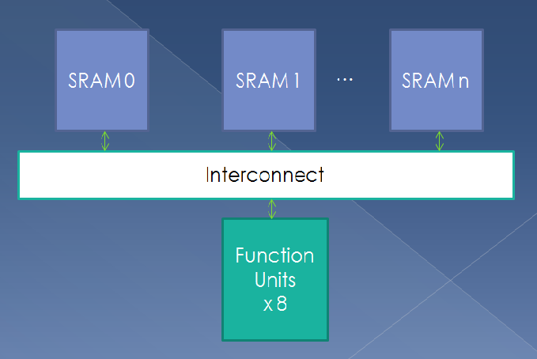
Issues with load/store ports
Limited # load/store ports
limits performance+data availability
Need large # SRAM ports
efficiently feed data to function units
BUT
degrades access time
power consumption
Solution
Banking
multiple small software managed scratch SRAMs
Power down unused SRAMs

Slide 6
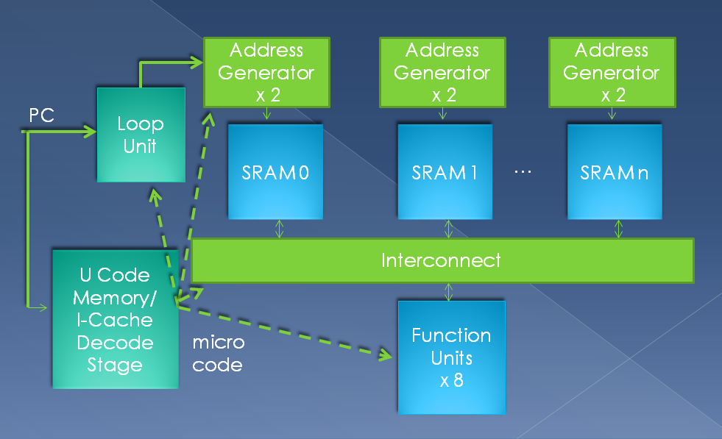
Working
1. VLIW instruction bundle
2. Load/store decoded
3. issued to address generators
VLIW execution unit - loop unit
4. Compiler configures loop unit before entering loop intensive code
5. Loop unit works autonomously.
6. PC passes 1st instruction of loop body => loop count ++
values used by AGs

Slide 7
Instructions Needed
write context instruction
~transfers loop parameters/data access patterns => context registers
( in loop unit/address generators)
load. context and store. context instructions
~enhanced versions of load/store instructions
~Two fields named context index and modulo period => immediate constant field
~Context. index :controls address calculation
push loop instruction
~used by compiler to inform hardware => nested inner loop is entered.

Slide 8
Modulo Scheduling
N cycles
The loop unit offers hw support for modulo scheduling
software pipelining
high loop performance
execution of new instance of loop body every II cycles
Non- modulo scheduled loop converted to modulo scheduled loop with II=N
LOOP BODY
II < N.

Slide 9
Modulo Scheduling cont
Original loop body => modulo scheduled
Replicating instructions
~instruction scheduled in cycle n is replicated to appears in all cycles
~ pasting new copy of the loop body at intervals
of II cycles over original loop body ~wrapping around all instructions that appear
after cycle N.
~ Instruction scheduled for cycle n
~ then n=II =>
modulo period

Slide 10
Modulo Scheduling
Compiler
Static Parameters
~ II
~ Loop Count Limits
PC -> Loop Body ??
Dynamic Values of loop variables
Loop Counter
Register File
Context registers

Slide 11
Loop Unit
Current loop
Pop loop
Push loop
Loop Stack
Start_count
Loop Contexts
MUX 2 x1
+1
clear
Write enable
||Count Reg
Loop Count Register x 4
||
=
loop_type, ||, start_count, end_count,
increment
Current loop
MUX 2 x1
End_count
increment
=
+
Next count

Slide 12
Loop Unit- Prior to starting a loop intensive section of code
Loop Parameter
Current loop
Pop loop
Push loop
Loop Stack
write context
Start_count
Loop Contexts
MUX 2 x1
+1
clear
Write enable
||Count Reg
Loop Count Register x 4
||
=
loop_type, ||, start_count, end_count,
increment
Current loop
MUX 2 x1
End_count
increment
=
+
Next count

Slide 13
Loop Unit – On entry into each loop body
T
Top of stack = current loop body
Push_loop
Current loop
Pop loop
Push loop
index of context register
Loop Stack
Start_count
Loop Contexts
MUX 2 x1
+1
+1
clear
Write enable
Reset!
||Count Reg
Loop Count Register x 4
||
||
=
loop_type, ||, start_count, end_count,
increment
Current loop
MUX 2 x1
End_count
increment
=
+
+
Next count

Slide 14
Loop Unit- When the end count of the loop is reached
Pop_loop
Current loop
Top entry = popped off stack
Pop loop
Push loop
Loop Stack
Start_count
Loop Contexts
MUX 2 x1
+1
clear
Write enable
||Count Reg
Loop Count Register x 4
Innermost loop completed
||
=
loop_type, ||, start_count, end_count,
increment
Current loop
MUX 2 x1
End_count
increment
=
+
Next count

Slide 15
Stream address generator
Loop Unit counters
Address context register file
Base address
Row size
How Compiler generates addresses
word oriented addressing
Elem size => size of Complex struct
row size => elem size* N
offset of imag within struct
Baseimag = BaseA + offset
Load into t1
Baseimag+i*row size+j* elem size
Vector= 1 D array
row size = 0
C row major
Select correct Loop variables

Slide 16
Stream address generator(2)
Address Calc (2)
Data Packing
Complex index
P*i+Q
Q=> Base address
P=> row size
Column walk
A[j][i]
If row size, elem sizes = powers of two
address = Base + [(i << x)| (j << y)]
Hierarchy
sum of powers of 2
multiple access expressions
Higher-D array
N-2 bases recalculated
Last 2 by hardware

Slide 17
Stream address generator(3)
Partner ALU
Write_context
Indirect access streams
A[B[i]]
Addr_gen cant compute
Address by Partner ALU
Many Addr _gen: 1 ALU in cluster
Computes address context
Reconfigures Addr_gen
1 cycle latency to load/store
Issued by Compiler
1 cycle
Low reconfiguration overhead
Array access pattern→ address context register
row , element sizes
base address
loop indices
4 context entries/ Addr_gen
support 24 //access patterns

Slide 18
Address Generation Steps
Compiler generates Array access code
address generator index
address context reg index
immediate field of Ld/ St
get array parameters from context field
Loop variables
Mux => loop variables
Shift loop variables
Pipeline
Better cycle time
Address = result + base_addr

Slide 19
Context reg from opcode
Loop Counters
Loop Counters
Address Context
Mux 4 x 1
Modulo
Period from opcode
Mux 4 x 1
J_sel
Opcode const
Mux 2 x 1
-
i_sel, j_sel, const_sel, alu_sel, x, y, Base address
Clock
Enable
y
<<
<<
Alu
address
x
Base address
Mux 2 x 1
Alu_sel
Pipeline Reg
Pipeline Reg
Pipeline Reg
+
Address

Slide 20
Special cases
Loop unrolling
Address calculation
1 loop variable + 1 unroll factor
In immediate field of the instruction
Input to upper 2x1 mux
ALU address computation
Selected by lower 2x1 mux
0/ 1 loop variables
loop counter = 0

Slide 21
Modulo Scheduling: Catch
Modulo period in Load.context/ Store.context != 0
overlap execution of multiple instances of inner loop
Example: Loop of latency=30 cycles
Can start instance after 5 cycles
No resource conflicts, data dependences
Loop variable ++ every 5 cycles
Old instances get wrong value
dependences for load/store instructions @loop end
6 instances in //
Problem!!

Slide 22
Modulo Scheduling: Solution
Traditional
Array Variable Renaming
Rotating Register File
Multiple copies of loop variable
Multiple address calculations
☹ long latency loop body
Single copy
Compensate for increment
Subtraction
Modulo period
Immediate field of Ld/ St
Throughput
Use entire scratchpad
Separate rotating reg for each array

Slide 23
Evaluation
Software running on a 400 MHz Intel XScale embedded processor
No floating point instructions
Replaced by integer instructions
For lower bound performance, energy
2.4 GHz Intel Pentium 4 processor.
No energy optimization
Optimized: No perception task support
Micro-code running on our VLIW architecture
custom ASIC

Slide 24
Evaluation (2)
Benchmarks
Metrics
Speech recognizer
Data-dependent branches
If-converted
Visual feature recognition
Image segmentation
Neural networks
Vectorizable
DSP, encryption
For generality
Floating-point
Integer
Throughput
Energy
to process 1 input block
Performance Vs Energy
Work per energy
Energy*delay
Normalized feature size
Constant field scaling
Delay: λ
Energy: λ^3
Architecture +Process

Slide 25
Evaluation (3)
Methodology
Instruments
Spice
Supply Current
Instantaneous power
Energy = ∫Power / time
SRAM
Log each read/ write/ idle cycle
Clock trees + loads
Netlists
Average processor current
Current probe
Digital Oscilloscope
PCB modification
Pentium
XScale
☹ DSP

Slide 26
Results
Out-of-order processing,
optimized
Better IPC
3.3x better
W.r.t. SGI MIPSPro
On-chip memory
Functional Unit utilization
High operand flow
Loop accelerator
Scratchpad

Slide 27
Results(2)
Note: Log scale on Y axis
Throughput
Real time performance
Stream computations
Throughput = #input packets processed per second
Normalized w.r.t. Pentium 4
VLIW architecture
1.75 x better than Pentium 4
41.4% of ASIC’s performance

Slide 28
Results(3)
Throughput is achieved at energy levels 13.5x better than XScale
Note: ASIC implementation was used for 4 benchmarks

Slide 29
Results (4)
Energy*delay
159x better than XScale
12 times worse than ASIC implementation
Advantages over General Processor/ ASIC
Better energy + performance
Programmable

Slide 30
Related study
Low power Scratchpad
IBM Elite DSP
Vector extensions
Operate on disjoint data
Reconfigurable Streaming Vector Processor
Base-stride vectors accelerated
Vector register files: less autonomy
Vector register files
Auto address generation
Hardcoded hardware scheduling
DSP Processors
bit-reversed addressing modes
auto ++
Author’s approach
Generic address generation
software scheduling + enhanced scalar loads +VLIW
multiple access patterns

Slide 31
Conclusion
Multiple SRAM
Distributed address generation
loop acceleration
Register Renaming
Advantages
ASIC: Power, Energy efficiency
Less costly
CPU: Generality
159 x better Energy*delay over Intel Xscale
1.75x performance over Pentium 4
Applications
speech recognition, vision, cryptography
Real-time
Within embedded energy budget

